Slide 1

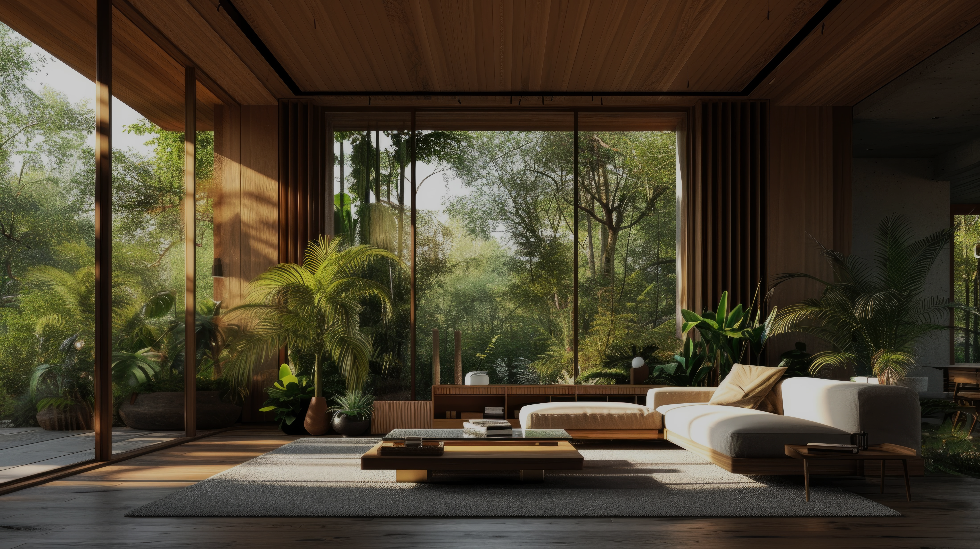









Table of
Contents
2081/11/27
FlyEasy
Simplifying Flight
Reservation
From Login to Seat Booking
Using C language
Notes:
https://www.freepik.com/free-ai-image/photorealistic-timber-house-interior-with-wooden-decor-furnishings_152371631.htm

Slide 2



















Table of
Contents
2081/11/27
Using C language
Notes:
https://www.freepik.com/free-ai-image/photorealistic-timber-house-interior-with-wooden-decor-furnishings_152371631.htm

Slide 3

Project
Introduction
Your super-duper awesome mission goes right here. 10x your PPT skills with One Skill.
One Skill
PPT Connoisseur

Slide 4
Project
Introduction
Content:
1.Project Topic:
A C-based Flight Reservation System that allows users to sign up, log in, selection and booking seats.
2.Significance:
Simplifies the flight booking process for users.
Demonstrates the power of C programming in building real-world applications.
3.Objectives:
Create a user-friendly system for flight reservations.
Implement secure user authentication.
Provide an efficient seat booking mechanism.
4.Target Audience:
Travelers, airline management, and programming enthusiasts.

Slide 5
Project Overview
Here are the problems that users have
87%
93%
97%
of the target audience is experiencing this problem
of the target audience is looking for an alternative
of the target audience reports it as the biggest pain

Slide 6
Project Overview
Here are the project overview
Problem
Statement
Solution
Overview
Motivation
Booking flights and managing seats can be time-consuming and complex for users.
To create a simple, efficient, and scalable solution using C programming.
A menu-driven system with:
User authentication .
Flight selection.
Seat availability and booking.

Slide 7
Implementation Details
Your
Solution
Benefit 1
Provide more information about this point. Keep it short and sweet
Benefit 2
Provide a bit more information about your super-duper awesome solution over here. Keep it easy peasy lemon squeezy.
Provide more information about this point. Keep it short and sweet
Benefit 3
Learn More
Provide more information about this point. Keep it short and sweet

Slide 8
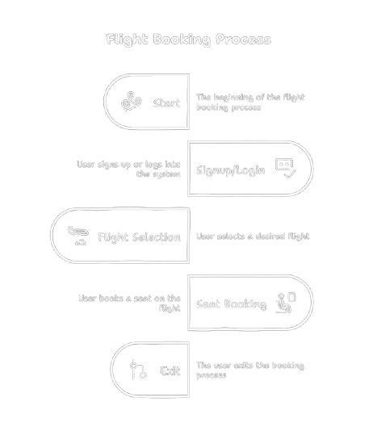
Implementation Details
File Handling
For storing user and flight details
Programming
Concepts
Array
For managing seats and user details
Standard C libraries:
stdio.h
stdlib.h
string.h
ctype.h
time.h
windows.h
Loops and Switch case
For menu navigation
Input validation
To handle user errors

Slide 9
Code
Walkthrough

Slide 10
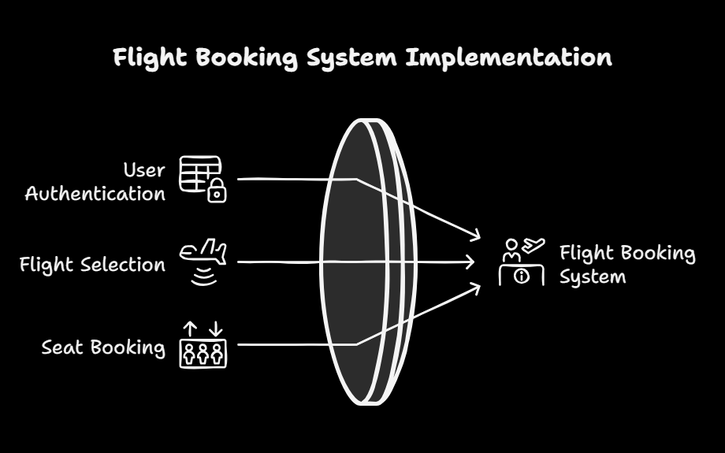
Code
Walkthrough

Slide 11
Testing &
Results
Overview of our
business model
1
2
3
4
5
Provide more info about this business model stage
Provide more info about this business model stage
Provide more info about this business model stage
Provide more info about this business model stage
Provide more info about this business model stage

Slide 12
Testing &
Results
Overview of our Project

Slide 13
Code
Conclusion
Key milestones
LAUNCH
TESTING
DEVELOPMENT
CONCEPT
ANALYSIS
JAN
FEB
MAR
APR
MAY
JUN
JUL
AUG
SEP
OCT
NOV
DEC

Slide 14
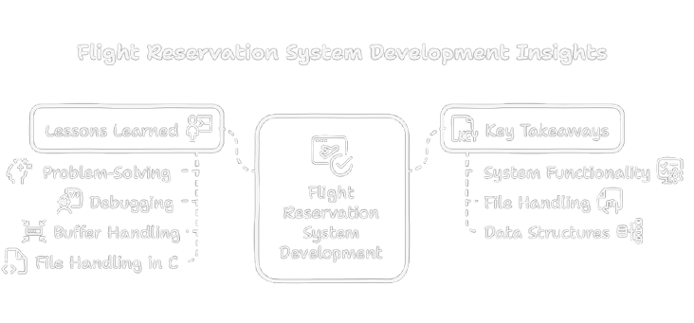
Code Conclusion

Slide 15
Q&A Session
We're well positioned to win in this market.
Top
LOGO
LOGO
Left
Right
LOGO
LOGO
Bottom

Slide 16
Q&A Session
Asking For Queries

Slide 17
Future Enhancement

Slide 18
Further Enhancement
‘
Reviews & Enhancement Ideas
Collection

Slide 19
This was our project work
Thankyou!

Slide 20

Our Team
Our top experts are ready to reach the goals
Obi Wan
Han Solo
Princess Leia
Raminta Art
One Skill
CEO
CTO
CFO
CMO
PPT

Slide 21

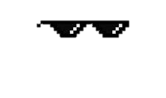
Our Team
We
“The Visionaries”
are ready to reach our goals
Asbin Moktan
Manjesh Pradhan
Prabesh Subedi
Nirmal Tamang
Team Leader
Team Member
Team Member
Team Member

